Slide 1

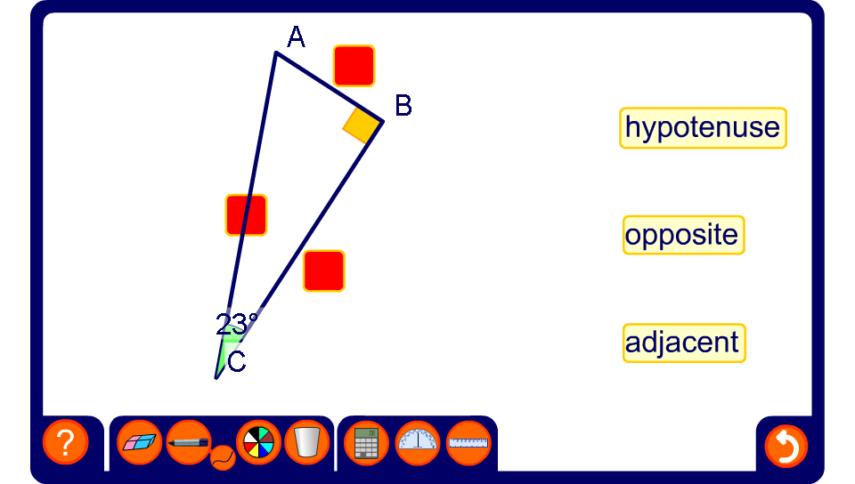


Label the sides
Notes:
Use this activity to practice labelling the sides of a right-angled triangle with respect to angle θ.
Ask volunteers to come to the board to complete the activity.

